Slide 1
數位系統實驗
Thu 9:00 am – 12:00 am
陳培殷
國立成功大學 資訊工程系

Slide 2
Outline
Video preview for 數位系統簡介+邏輯閘+布林代數
Lab I--Boolean Algebra
Lab II--XOR
Lab III--Half Adder
Lab IV(practice)--Comparator

Slide 3
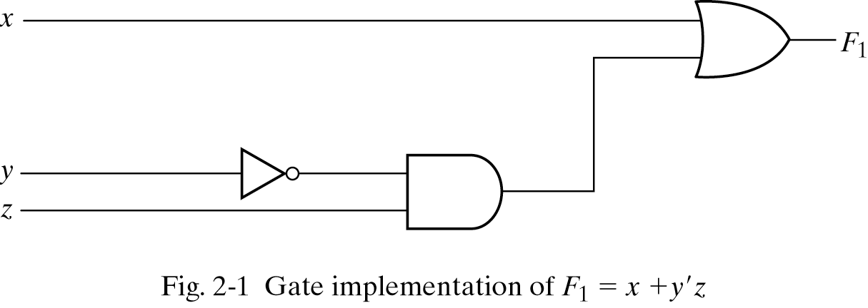
Three representations for a circuit
1. Boolean Algebra
2. Truth Table
真值表
n input variables ➔ 2^{n} combinations
F₁=x+y’z
Inputs
3. Circuit Diagram

Slide 4
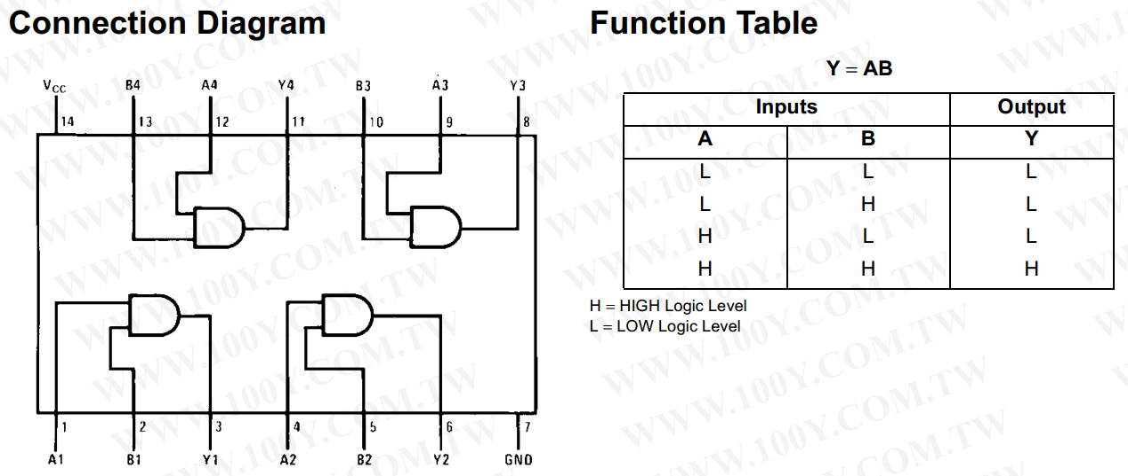
74LS08
AND gate
Boolean Algebra
F=xy

Slide 5
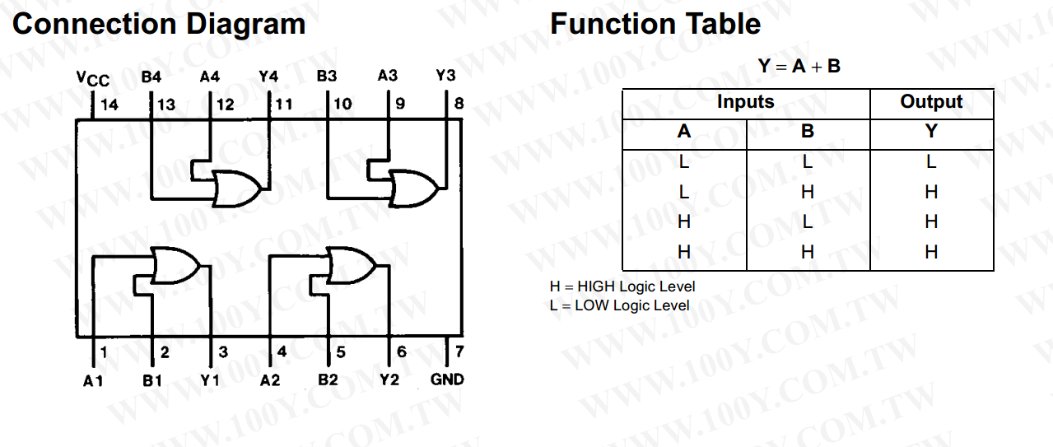
74LS32
OR gate
Boolean Algebra
F=x+y

Slide 6
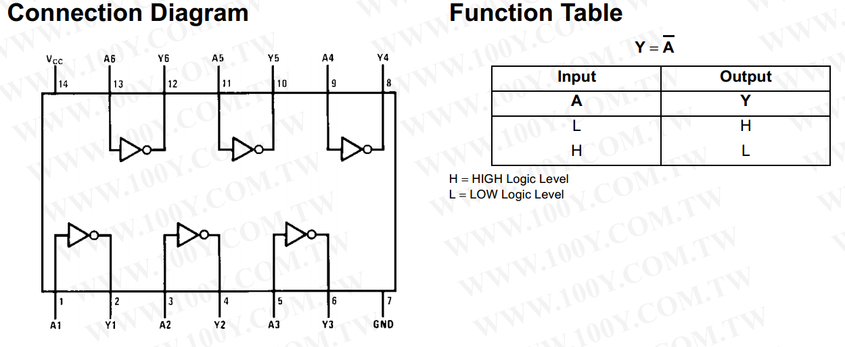
74LS04
NOT gate
Boolean Algebra
F=x’

Slide 7
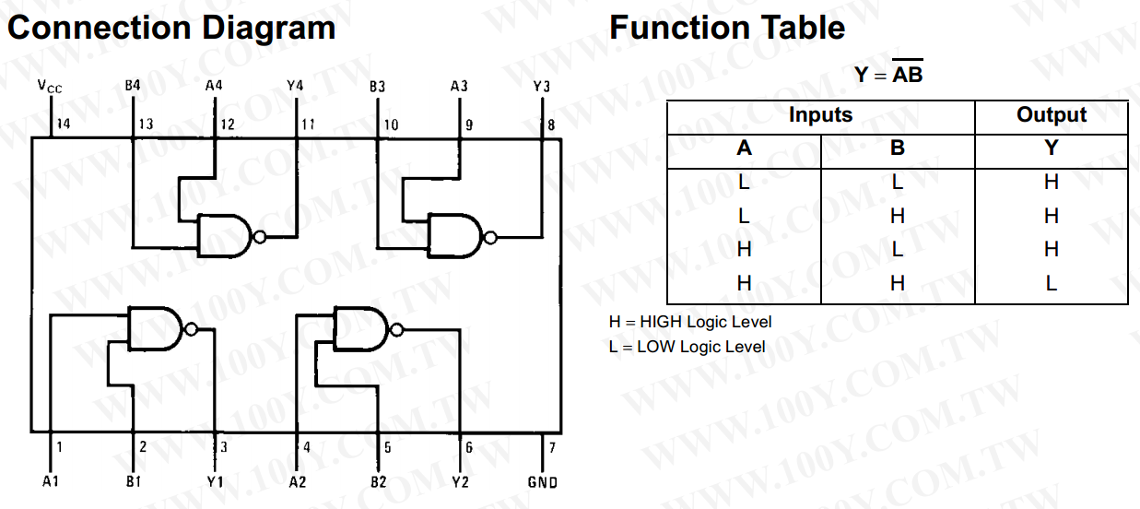
74LS00
NAND gate
Not - AND
Boolean Algebra
F=(xy)’

Slide 8
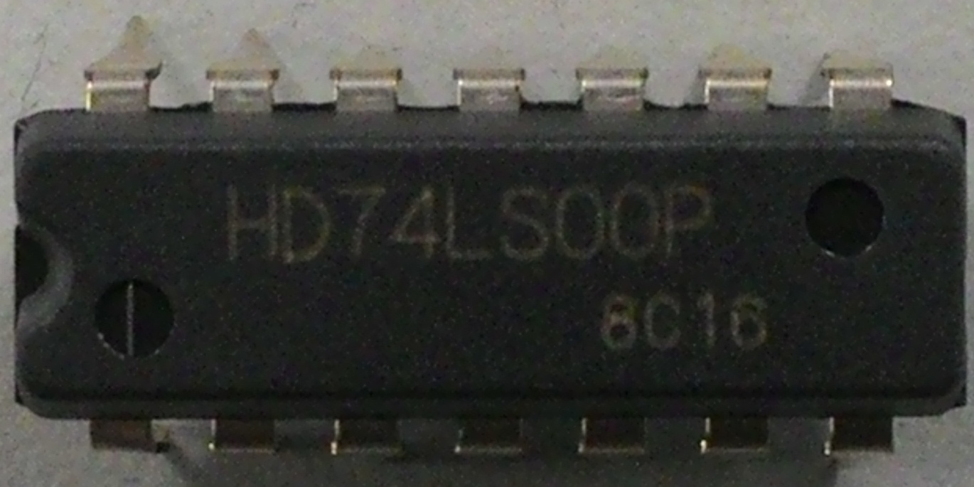
74LS00
NAND gate
Vcc (5V)
B3 A3 Y3
A1 B1 Y1
ground

Slide 9
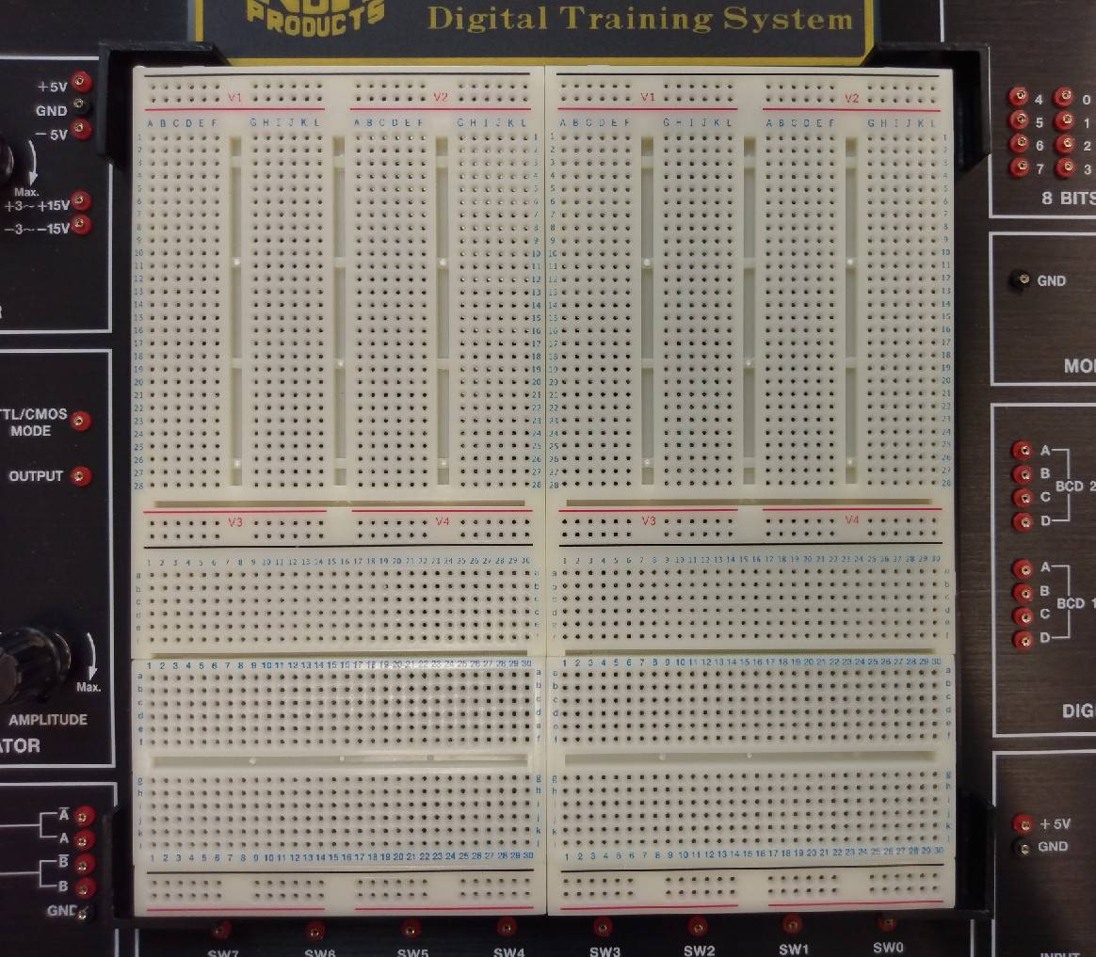
The Solderless Breadboard in CSIE NCKU
Top view of the breadboard
NOT
AND
NAND
OR

Slide 10
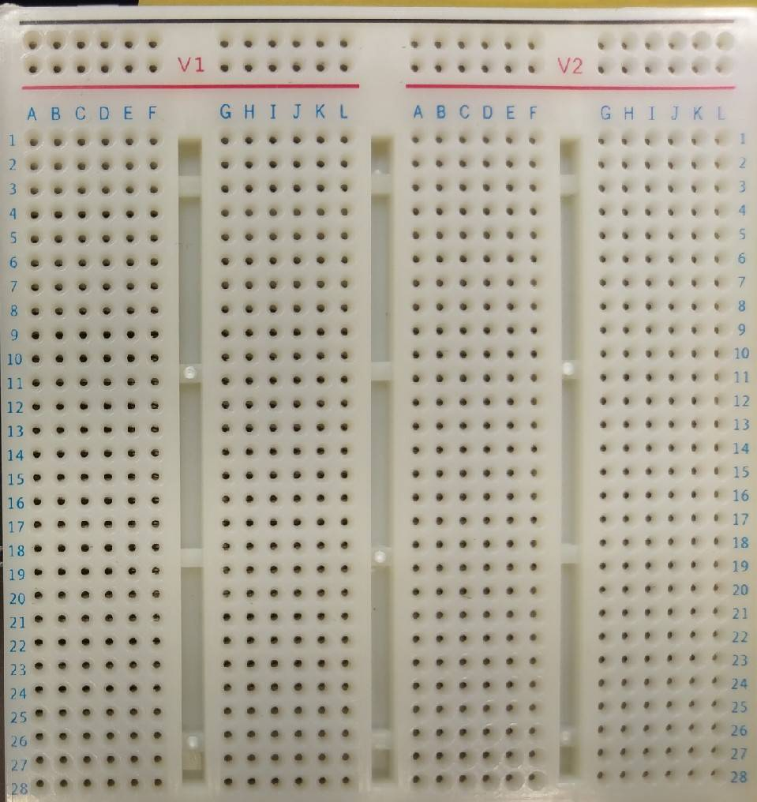
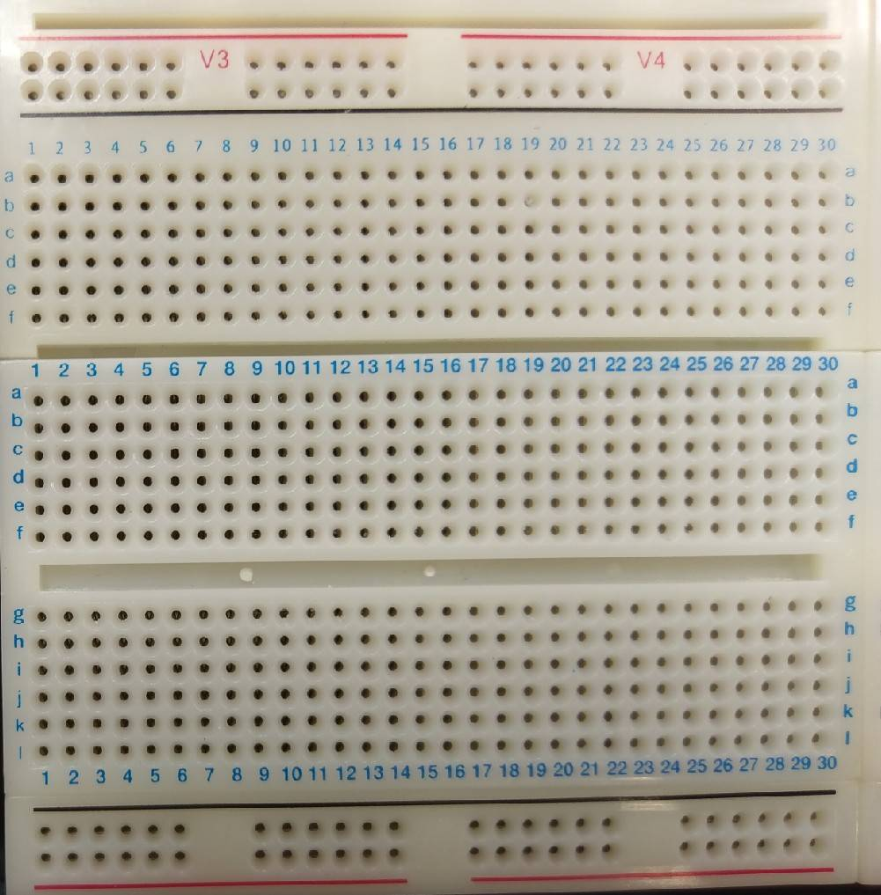
Top View of the Solderless Breadboard
: connected : disconected
Let a input be shared to two logic gate

Slide 11
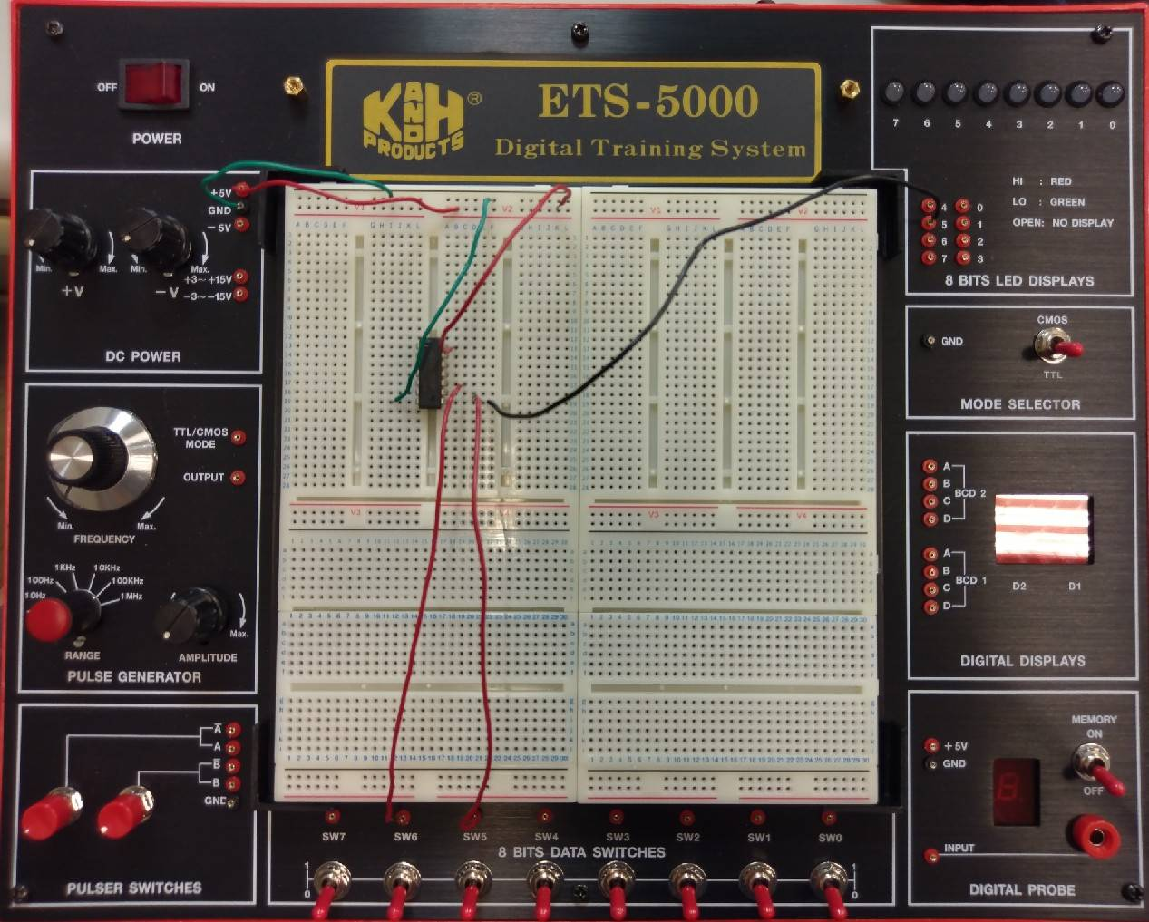
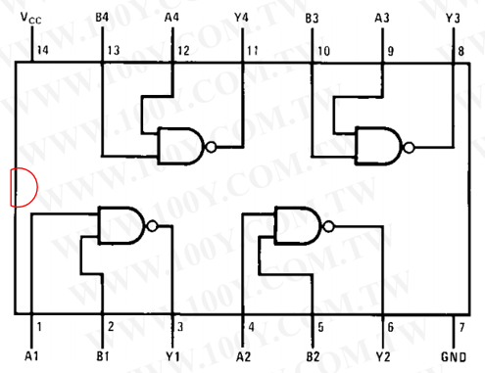
Example: Connection with 74LS00 Chip(1/7)
Board
output
power supply
TTL mode
Chip(NAND)
Wire connection & IC placement
input

Slide 12
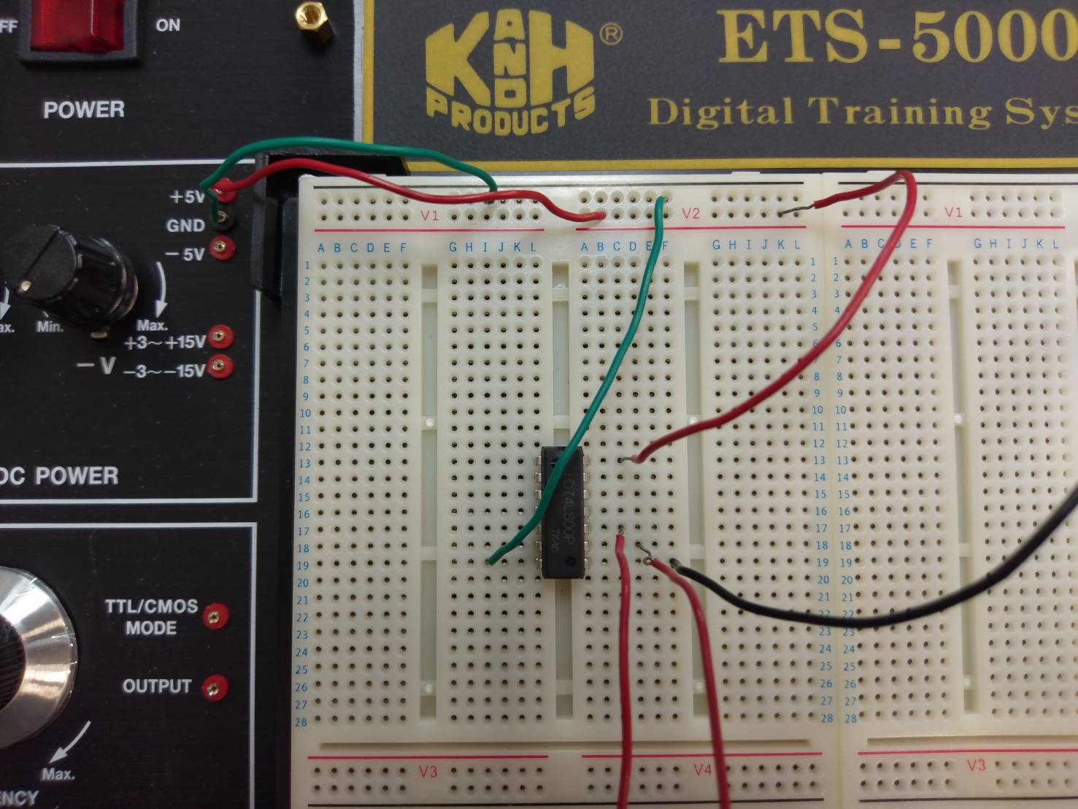
Example: Connection with 74LS00 Chip(2/7)
Board : wire connection
Chip(NAND)
Vcc (5V)
ground

Slide 13
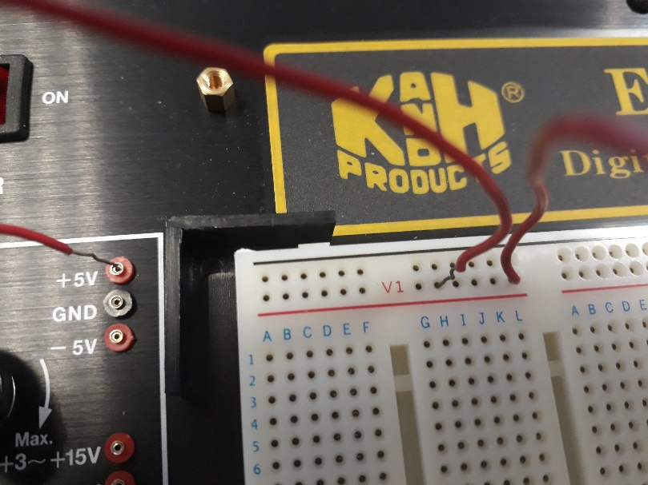
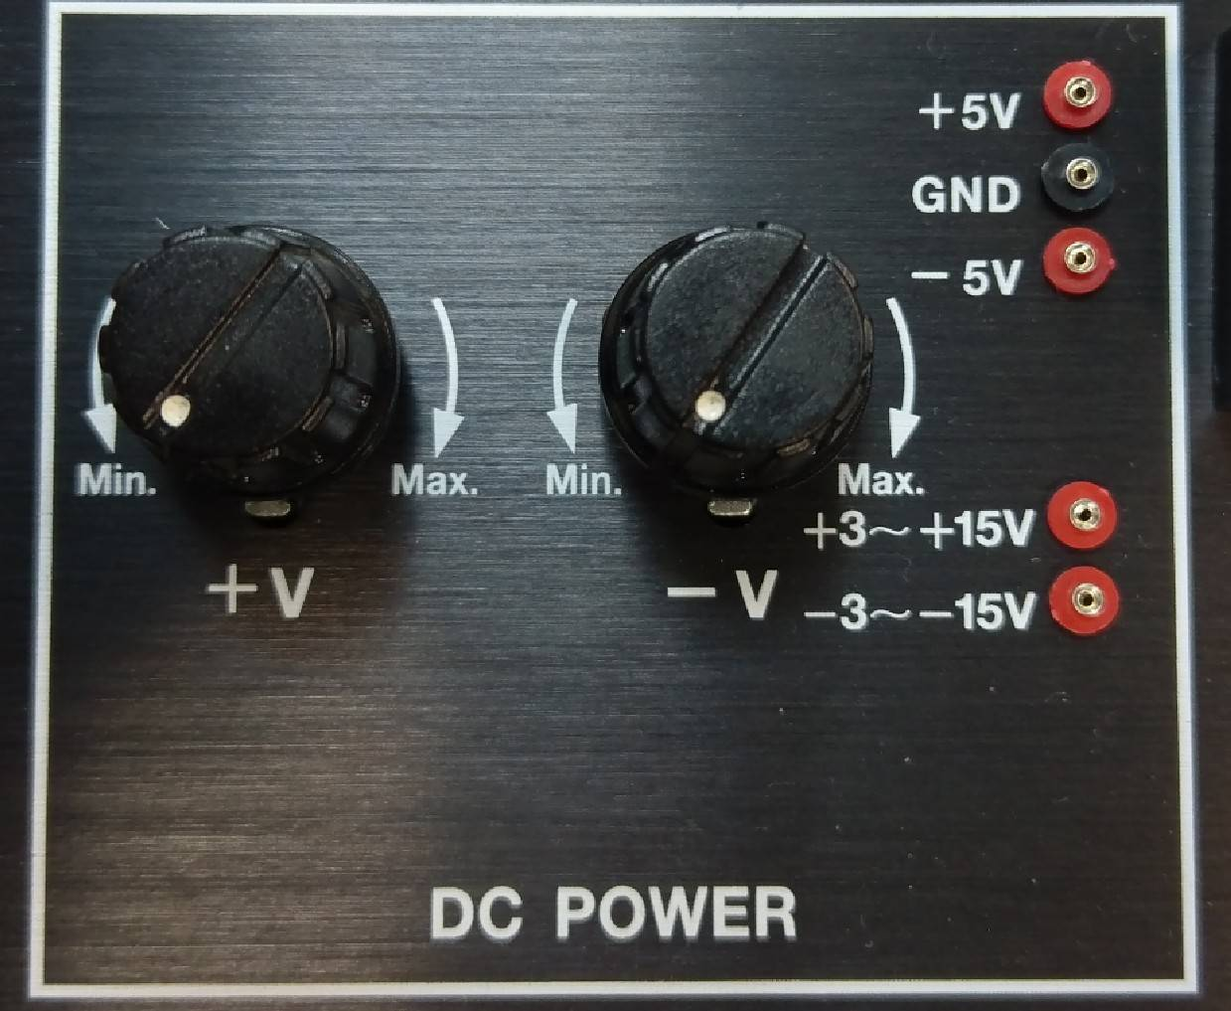
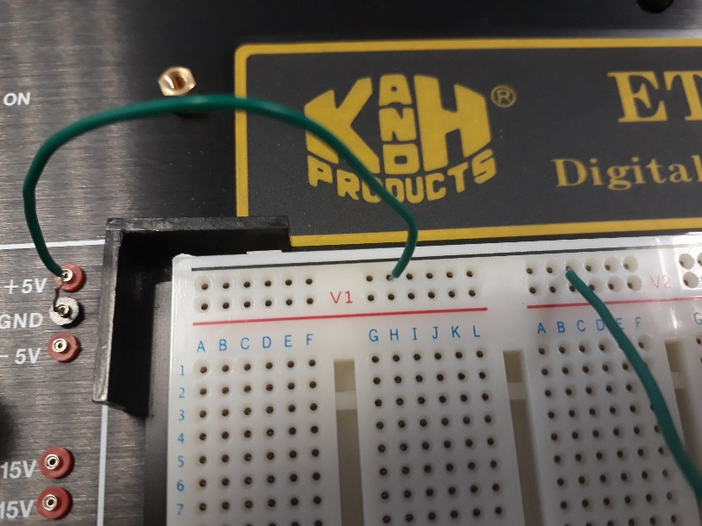
Example: Connection with 74LS00 Chip(3/7)
VCC
Power supply
GND

Slide 14
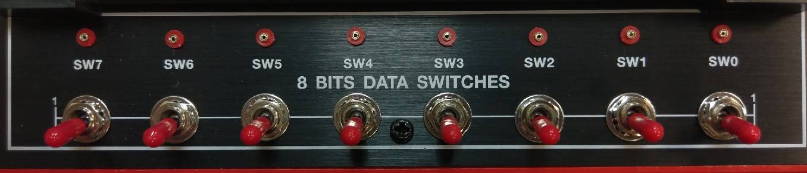
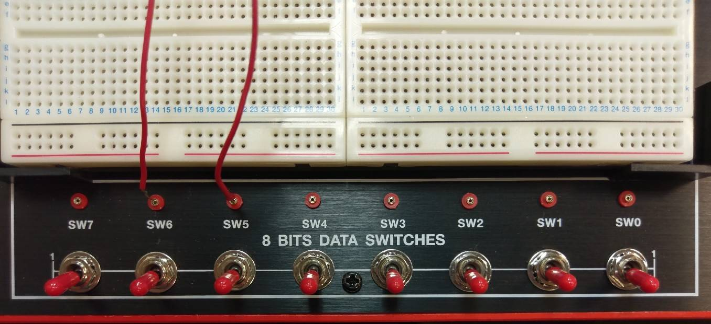
Example: Connection with 74LS00 Chip(4/7)
Signal input

Slide 15
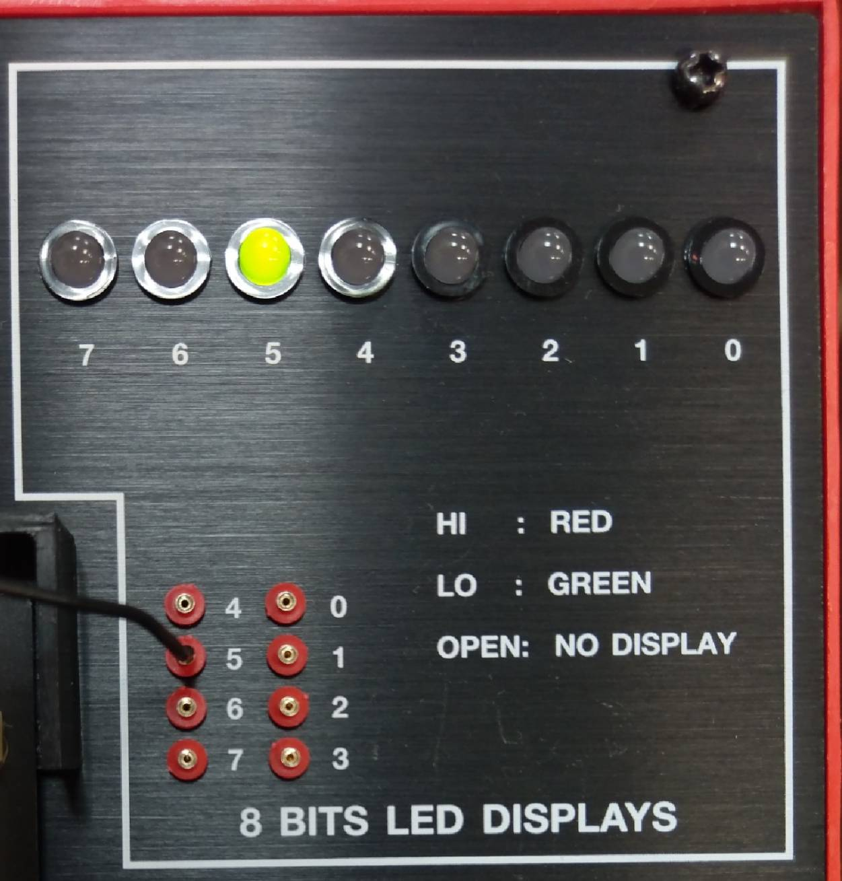
Example: Connection with 74LS00 Chip(5/7)
Signal output

Slide 16
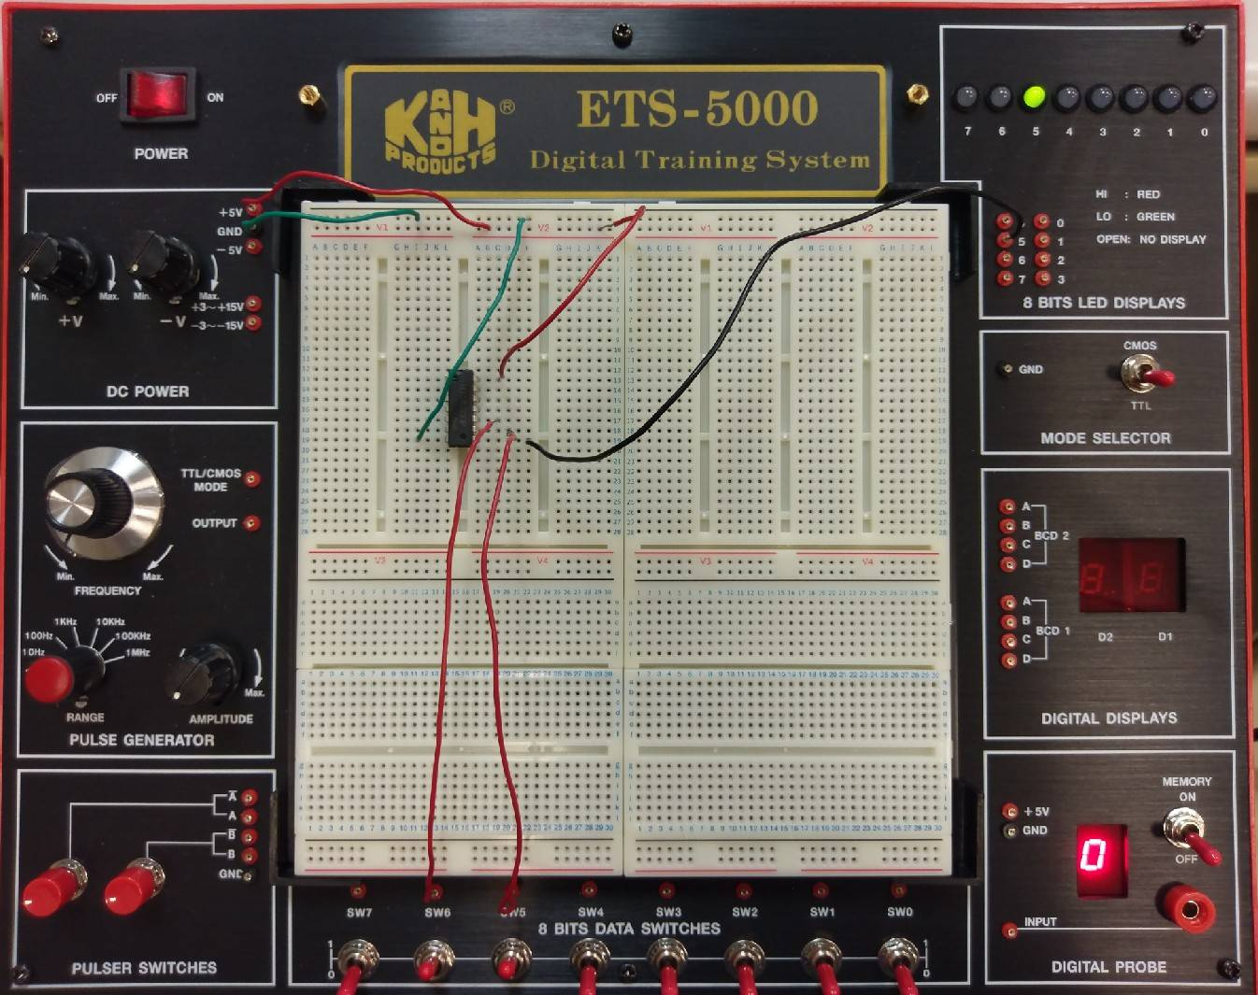
Example: Connection with 74LS00 Chip(6/7)
Input 11
Output 0
Y
74LS00 truth table
Input |  | Output
A | B | Y
0 | 0 | 1
1 | 0 | 1
0 | 1 | 1
1 | 1 | 0
A
B

Slide 17
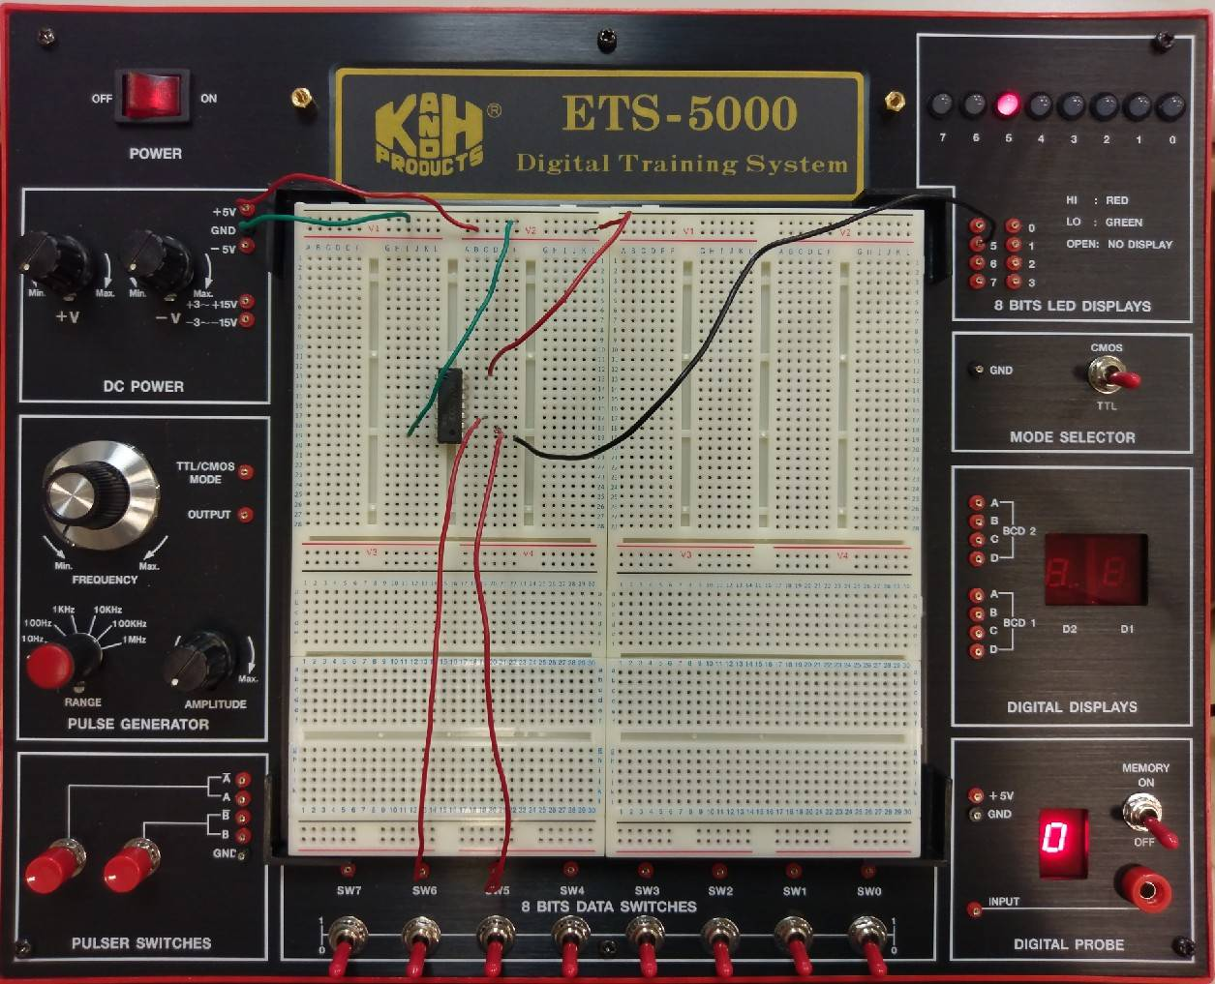
Example: Connection with 74LS00 Chip(7/7)
Input 00
Output 1
Y
74LS00 truth table
Input |  | Output
A | B | Y
0 | 0 | 1
1 | 0 | 1
0 | 1 | 1
1 | 1 | 0
A
B

Slide 18
Lab I
Please draw their Truth Tables and implement the circuits with breadboard.
F₁(A, B) = (A+B’)(A’+B)
F₂(A, B) = (AB)’(A + B)
Notes:
錯誤：此時不需化簡(已修正)

Slide 19
Components needed for LAB I
Names | Amount
Solerless Breadboard | ×1
74LS00 | ×1
74LS04 | ×1
74LS08 | ×1
74LS32 | ×1

Slide 20

Lab II – XOR (1/2)
1. Boolean Algebra
2. Truth Table
F = A + B
A | B | F
0 | 0 | 0
0 | 1 | 1
1 | 0 | 1
1 | 1 | 0
=> F = A’B + AB’
3. Circuit Diagram
A
F
B

Slide 21
LAB II -- XOR (2/2)
Please
(a) implement the circuit on the breadboard.

Slide 22
Components needed for LAB II
Names | Amount
Solerless Breadboard | ×1
74LS04 | ×1
74LS08 | ×1
74LS32 | ×1

Slide 23
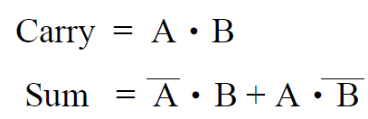
LAB III -- Half Adder (1/5)
A half adder (HA) consists of two inputs (A and B) and two outputs (Sum and Carry). “A” denotes the summand and “B” is the addend. Sum and Carry mean the output sum and carry for input “A” and “B”. The truth table and Boolean algebra for the half adder are as follows.
A | B | Carry | Sum
0 | 0 | 0 | 0
0 | 1 | 0 | 1
1 | 0 | 0 | 1
1 | 1 | 1 | 0
 |  | A
+ |  | B
 | Carry | Sum
Example:

Slide 24
LAB III -- Half Adder (2/5)
Please
(a) implement the circuit on the breadboard and show the result on LED.
(b) show the result with decimal format (0, 1, 2, …..,9) on Digital Display in the breadboard.

Slide 25
LAB III -- Half Adder (3/5)
A half adder (HA) consists of two inputs (A and B) and two outputs (Sum and Carry). “A” denotes the summand and “B” is the addend. Sum and Carry mean the output sum and carry for input “A” and “B”. The truth table and Boolean algebra for the half adder are as follows.
A | B | Carry | Sum | Decimal
0 | 0 | 0 | 0 | 0
0 | 1 | 0 | 1 | 1
1 | 0 | 0 | 1 | 1
1 | 1 | 1 | 0 | 2
 |  | A
+ |  | B
 | Carry | Sum
Example:

Slide 26
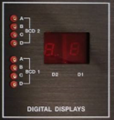
Digital Display in the breadboard
Function of the Digital Display in the breadboard is as follows.
D | C | B(Carry) | A(Sum) | DIGITAL DISPLAY
0 | 0 | 0 | 0 | 0
0 | 0 | 0 | 1 | 1
0 | 0 | 1 | 0 | 2
0 | 0 | 1 | 1 | 3
0 | 1 | 0 | 0 | 4
0 | 1 | 0 | 1 | 5
0 | 1 | 1 | 0 | 6
0 | 1 | 1 | 1 | 7
1 | 0 | 0 | 0 | 8
1 | 0 | 0 | 1 | 9

Slide 27
Components needed for LAB III
Names | Amount
Solerless Breadboard | ×1
74LS04 | ×1
74LS08 | ×1
74LS32 | ×1

Slide 28
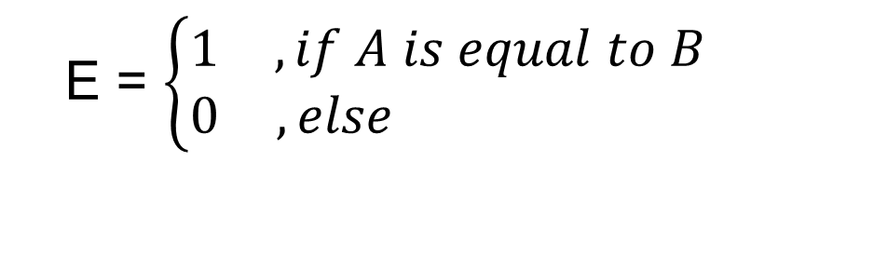
Lab IV – Comparator (1/2)
There are two inputs denoted as A and B. Both A and B are 1-bit value. A comparator is designed to determine whether A is equal to B or not. The output results are represented with E .
The function and truth table of the comparator is described as follows.
A | B | F
0 | 0 | 1
0 | 1 | 0
1 | 0 | 0
1 | 1 | 1
E = $\left\{\begin{matrix}1 & , if A is equal to B \\ 0 & ,else \end{matrix}\right.$

Slide 29
Lab IV – Comparator (2/2)
Please
(a) Write boolean algebra and implement the circuit on the breadboard.

Slide 30
Components needed for LAB IV
Names | Amount
Solerless Breadboard | ×1
74LS04 | ×1
74LS08 | ×1
74LS32 | ×1

